Slide 1

Course Code: MKTM518
Course Title: Integrated Marketing Communication
Course Instructor: Dr. Abhishek Sharma
Academic Task Number: 1
Date of Submission: 11th July, 2025
Name: Chaitanya Giri Goswami
Registration Number: 12411084

Slide 2
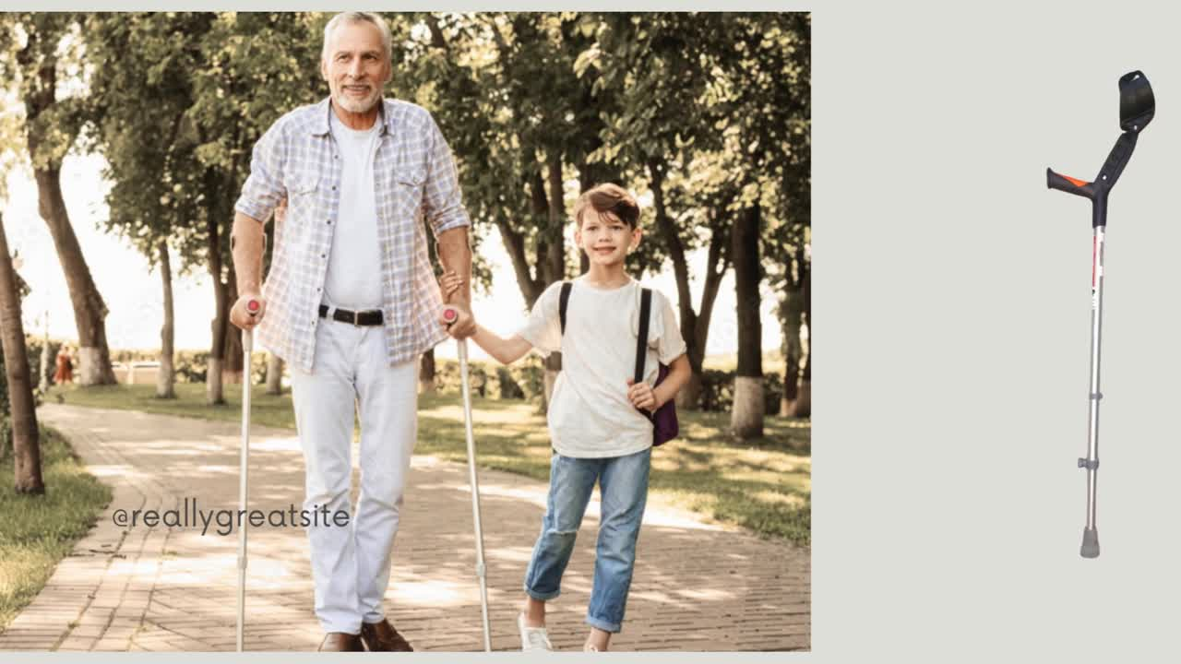

Slide 3
Objective of the advertisement
The advertisement focuses on the comfort, stability, and independence provided by the Elbow Crutch.
It targets individuals recovering from injuries or managing long-term mobility challenges.
The product is positioned as more than a medical aid — it’s a support system for daily life.
The core message emphasizes the Elbow Crutch as a reliable partner in achieving freedom and self-reliance.

Slide 4
Types of Advertising Appeal Used
Rational
The advertisement uses a rational appeal to connect with the audience.
It highlights practical benefits such as lightweight design, adjustability, ergonomic grip, and daily usability.
The appeal targets people who prioritize functionality and reliability in health-related products.
The primary audience includes elderly individuals, post-surgery patients, and caregivers seeking dependable mobility aids.

Slide 5
Why particular appeal and target audience
A rational appeal was selected due to the product’s functional and health-related nature.
Consumers in this segment prioritize evidence-based decision-making.
Key buying factors include comfort, quality, safety, and user-friendliness.

Slide 6
Preferred Media Channel
YouTube, Instagram and Facebook are preferred platforms for showcasing short, visually engaging videos that highlight real-life use and product features.
These platforms enable targeted advertising based on age, health interests, and caregiving roles

Slide 7

Thank You!

